Slide 1
Daily Data Aggregation
By
Sunkari Manohar

Slide 2
Agenda
Project Statement
Project Overview
Project Requirements
Architecture
Execution overview
Project implementation
Conclusion

Slide 3
Project Statement:
Implement a daily data aggregation pipeline using Azure Data Factory to move raw data and Azure Databricks to aggregate and summarize the data based on daily intervals.

Slide 4
Project Overview:
The project aims to use Azure Data Factory (ADF) and Azure Databricks to construct a daily data aggregation pipeline. With the help of this pipeline, raw data from source systems will be moved to a location where Azure Databricks will be used for daily data aggregation and summarization

Slide 5
Project Requirements:
Azure Subscription
Data Sources
Azure Storage account
Azure Databricks
Azure Data Factory

Slide 6
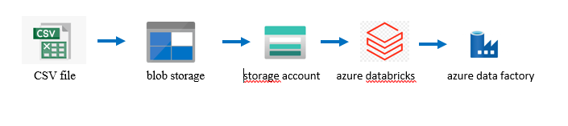
Architecture:

Slide 7
Execution Overview:
Login to the Azure Subscription account.
Create a storage account and upload a file inside a storage account container.
Create an Azure Databricks workspace.
Create a cluster and notebook in databricks workspace.
Connect ADLS with ADF.
Create Azure data factory resource.
Create pipeline for databricks in ADF.
Debug to get the final output.

Slide 8
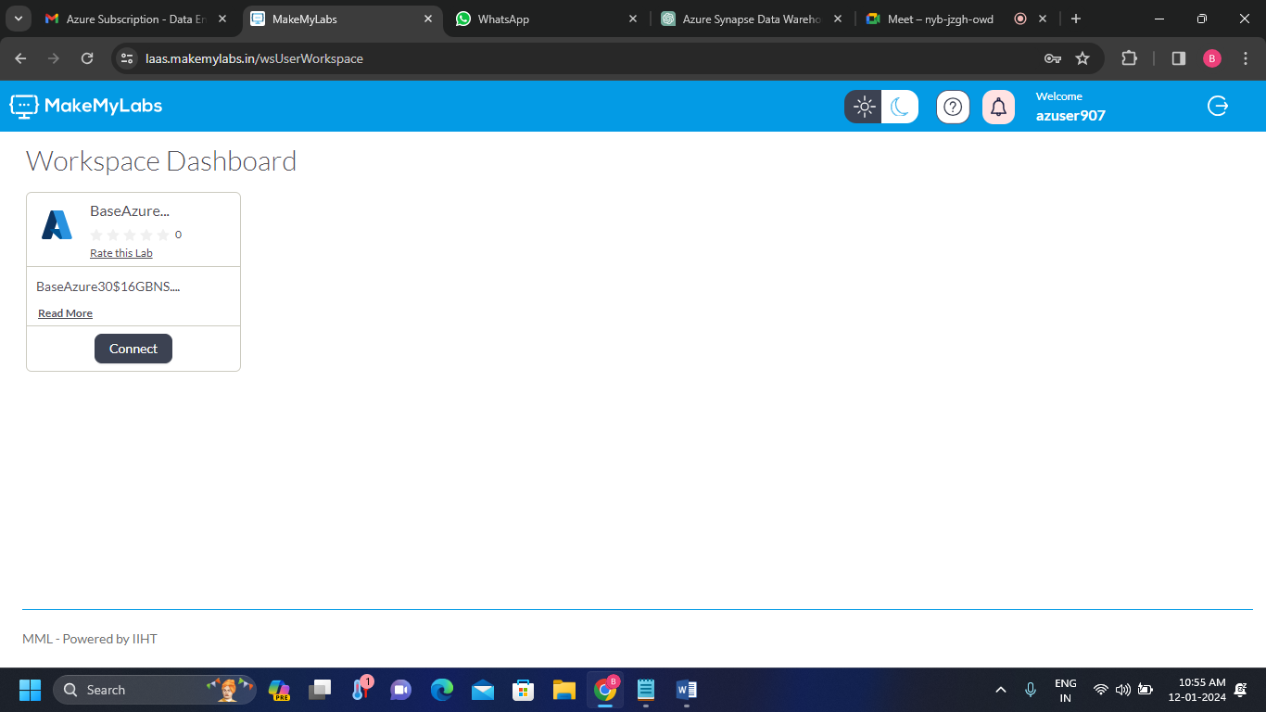
Project Implementation:
Azure account:
Log in to the Azure account and connect to the Workspace Dashboard.

Slide 9
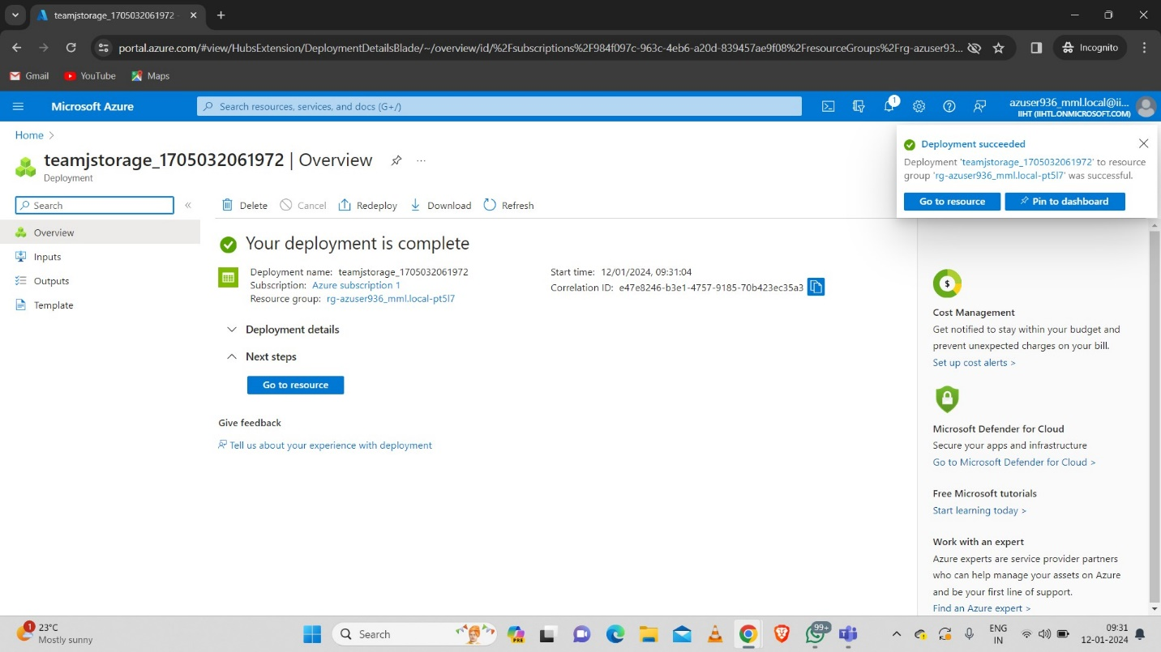
2. Storage Account:
Create a Storage account.

Slide 10
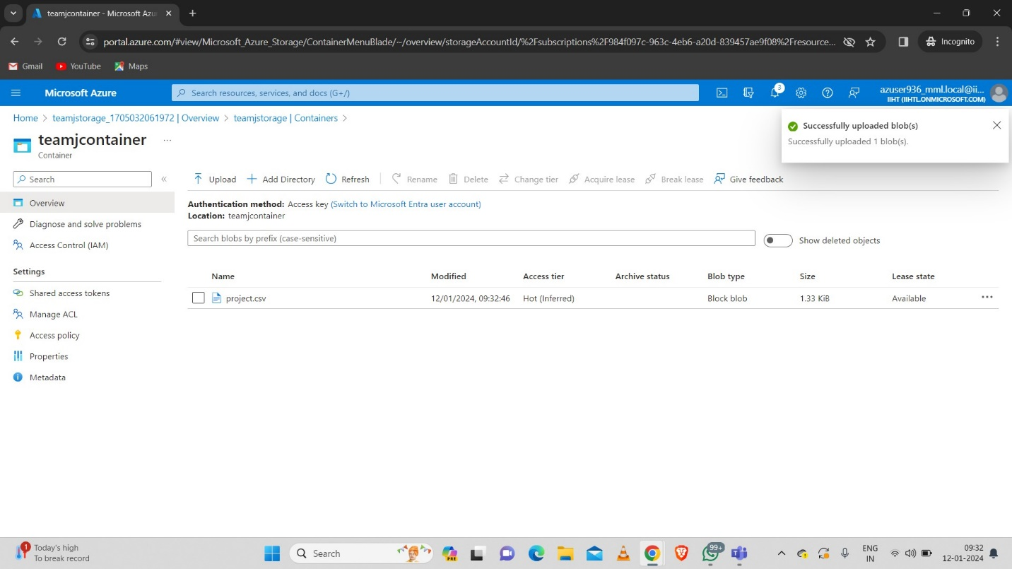
3.Uploading CSV File In Storage Account Container:
Upload the file inside the container.

Slide 11
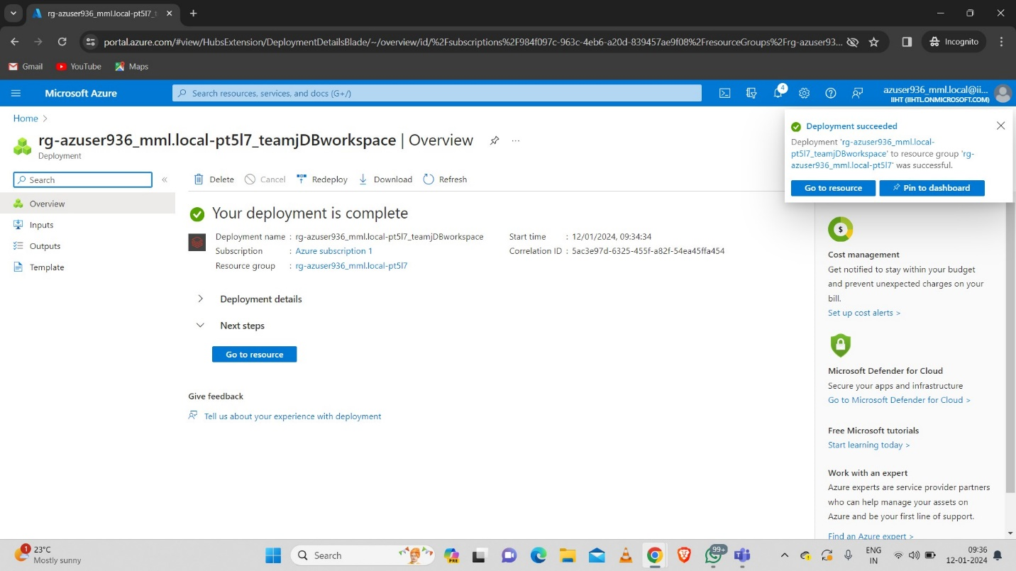
4. Azure Databricks:
Create an Azure databricks Workspace.

Slide 12
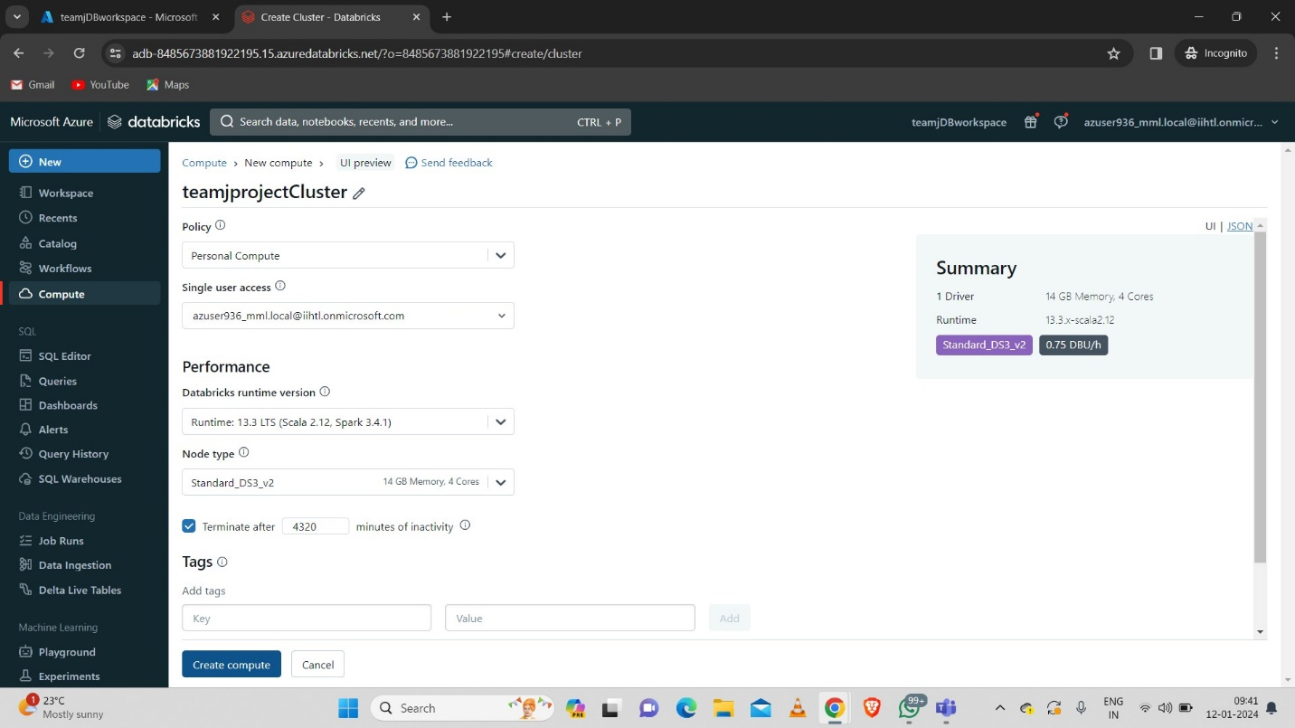
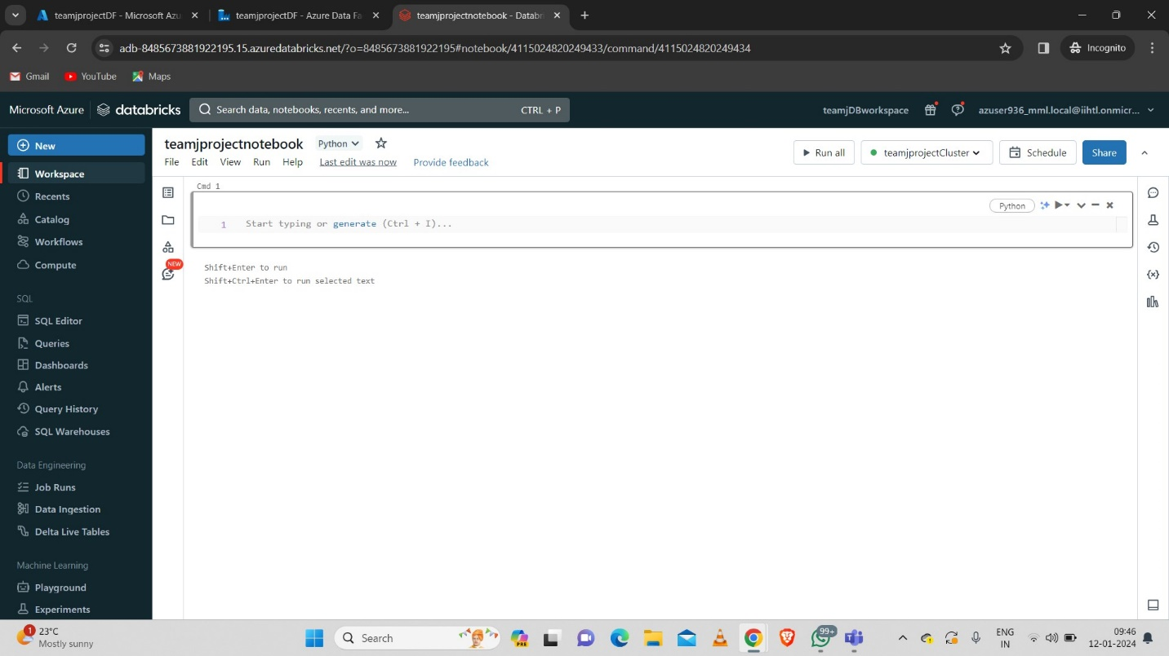
5. Creating Databricks Cluster And Notebook:
Create a Databricks Cluster and Notebook.

Slide 13
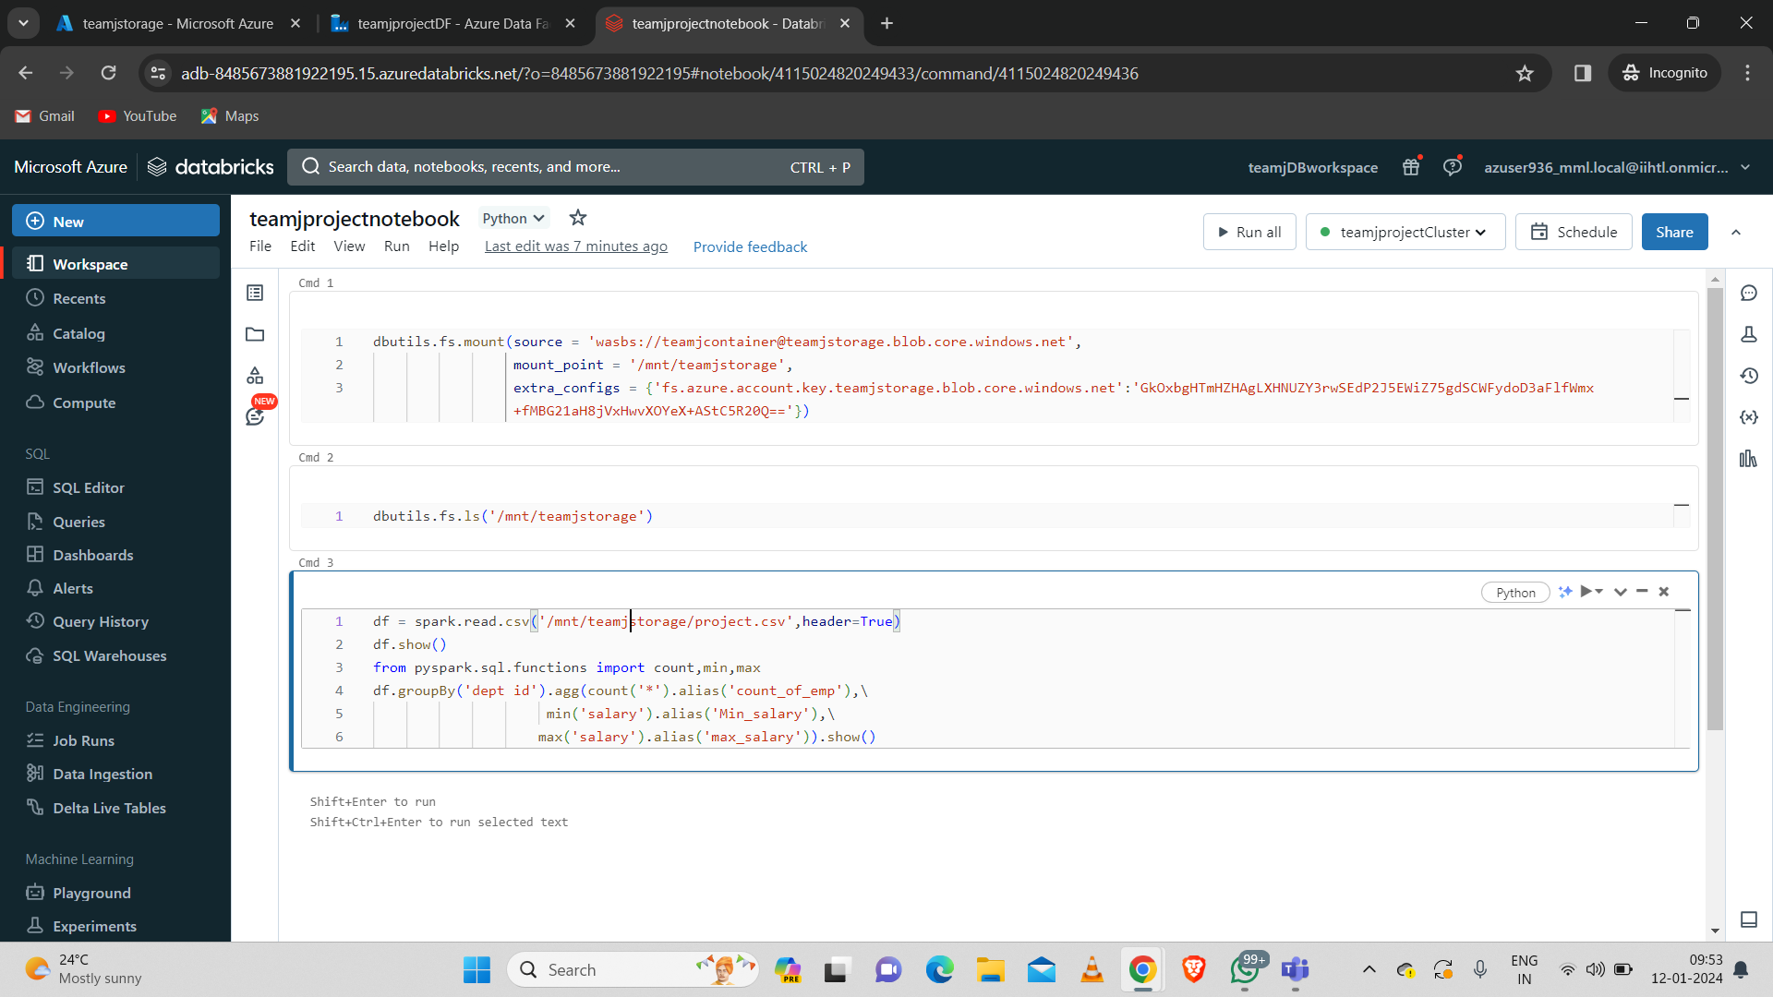
6. Mounting ADLS With Databricks:
Mount (Connect) the blob storage container with databricks with following command.

Slide 14
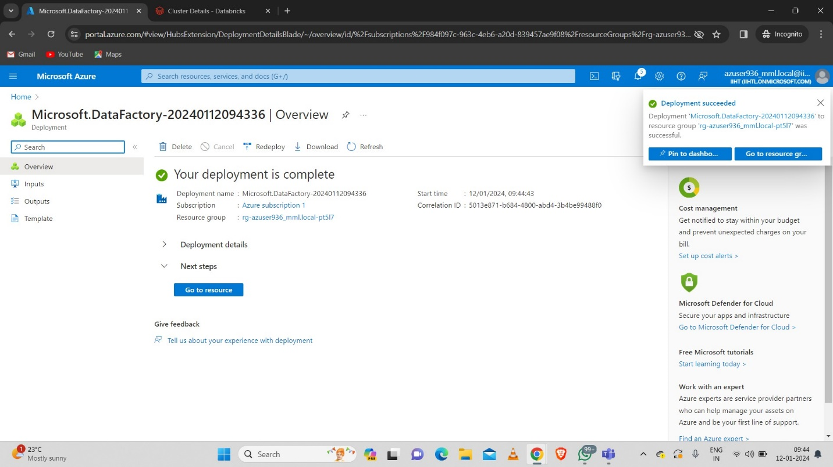
7. Azure Data Factory:
Create an Azure Data Factory.

Slide 15
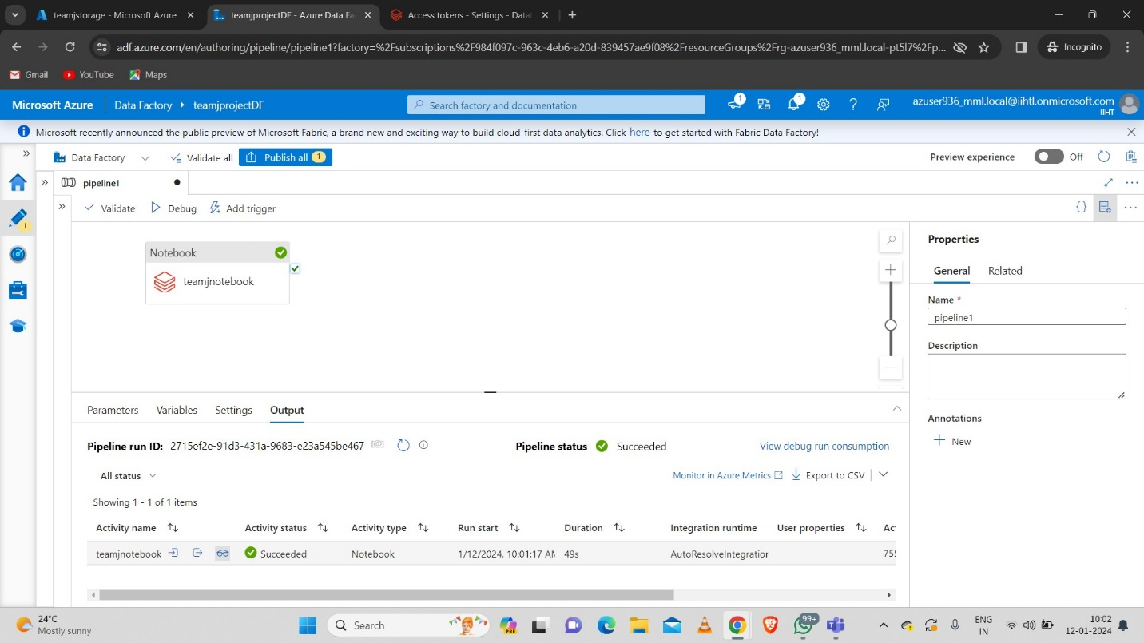
8. Integrating ADF With Azure Databricks:

Slide 16
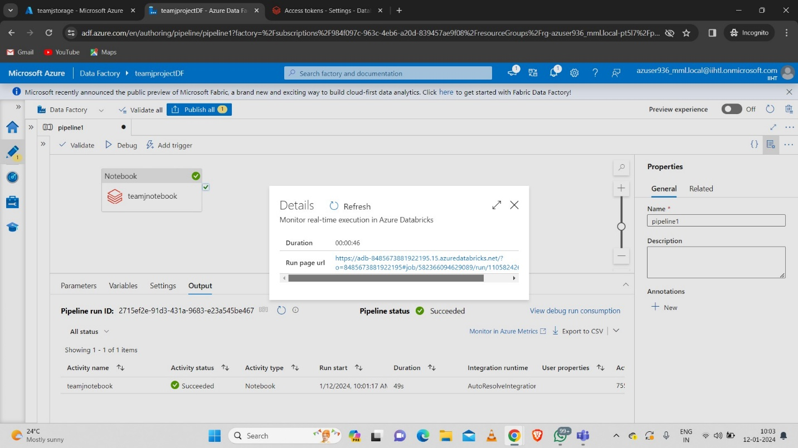
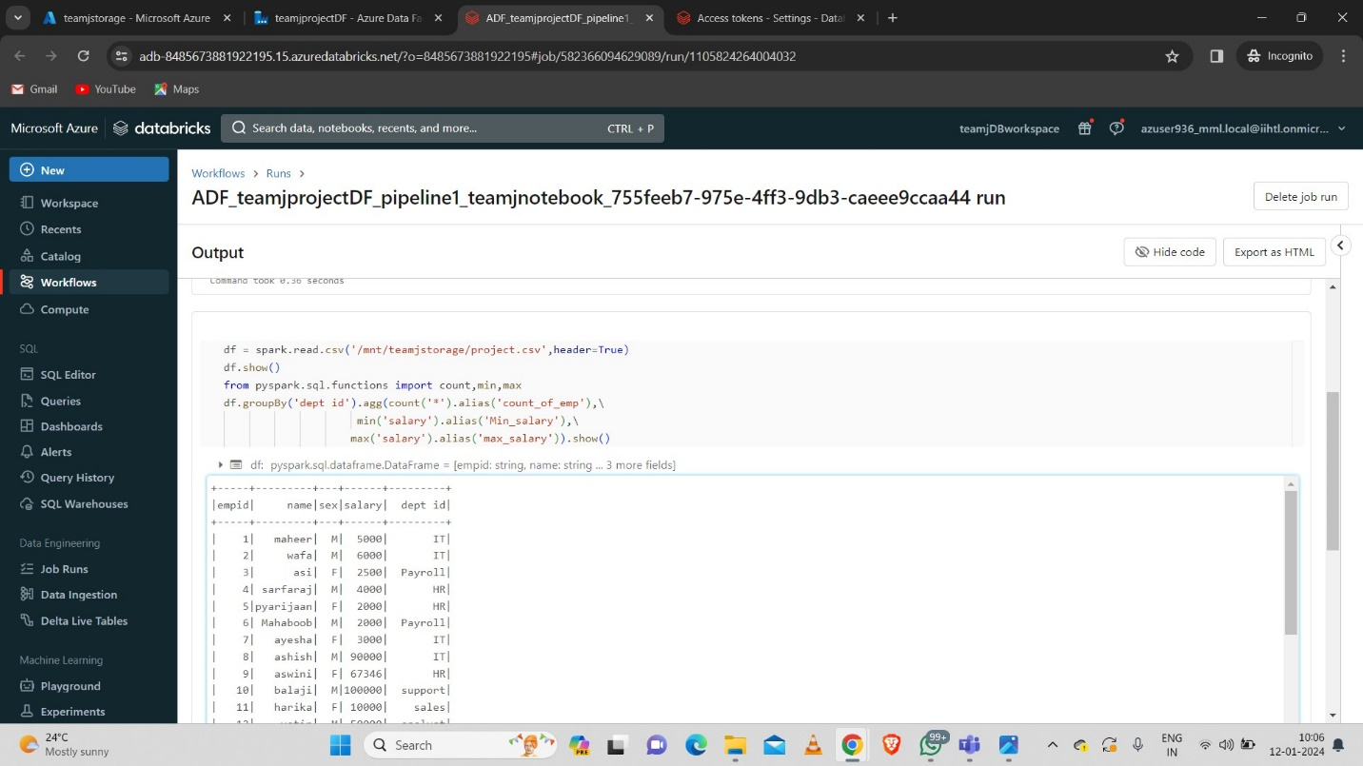
9. Final Output:
Click on details at the output of the pipeline after debugging.
Click on the url.

Slide 17
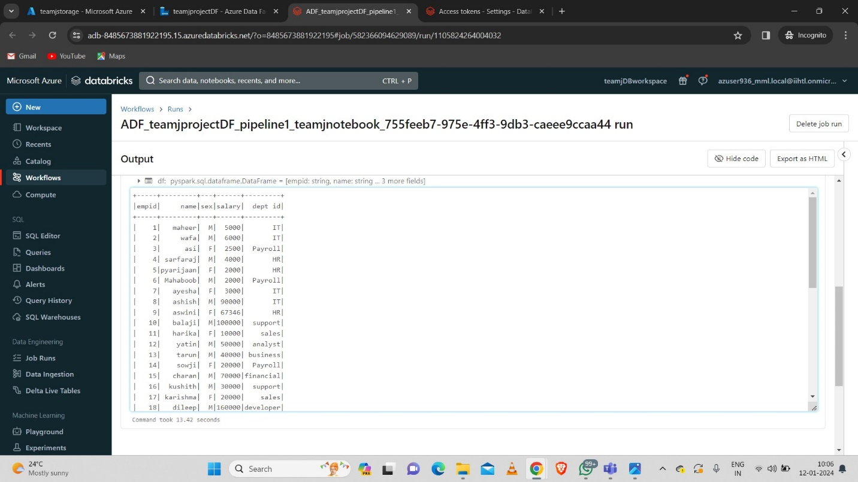
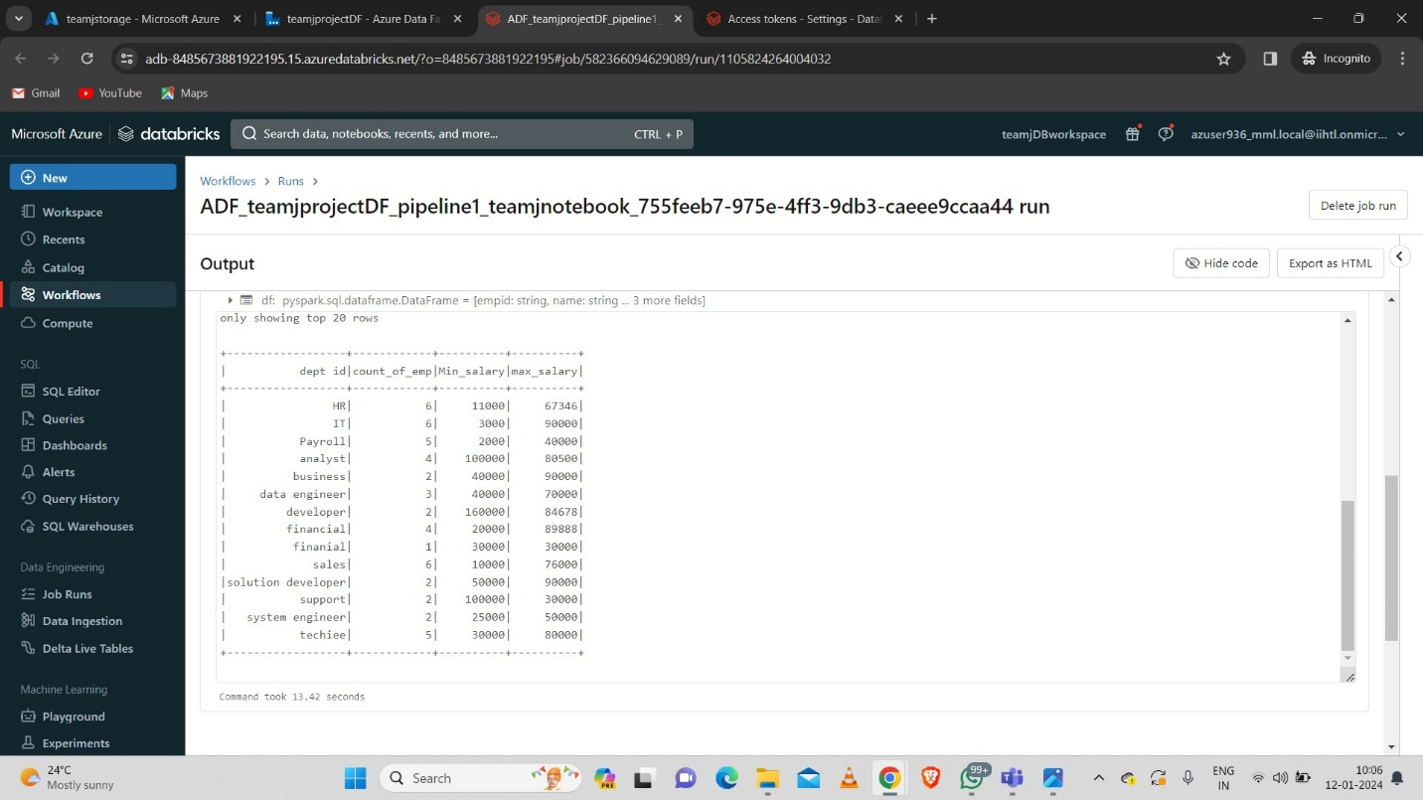
Output:

Slide 18
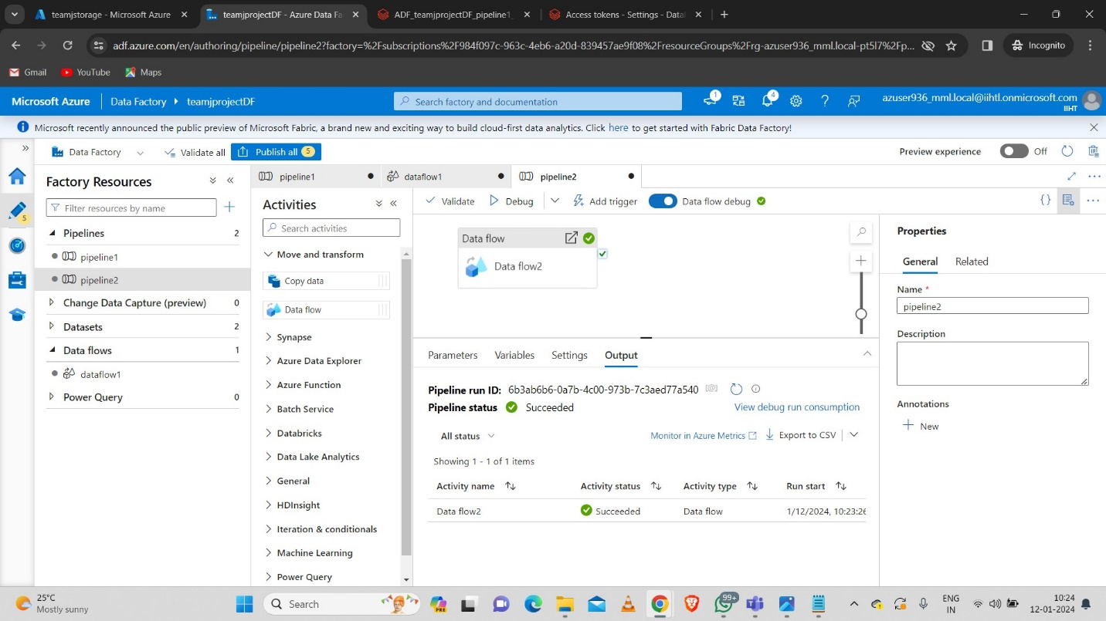
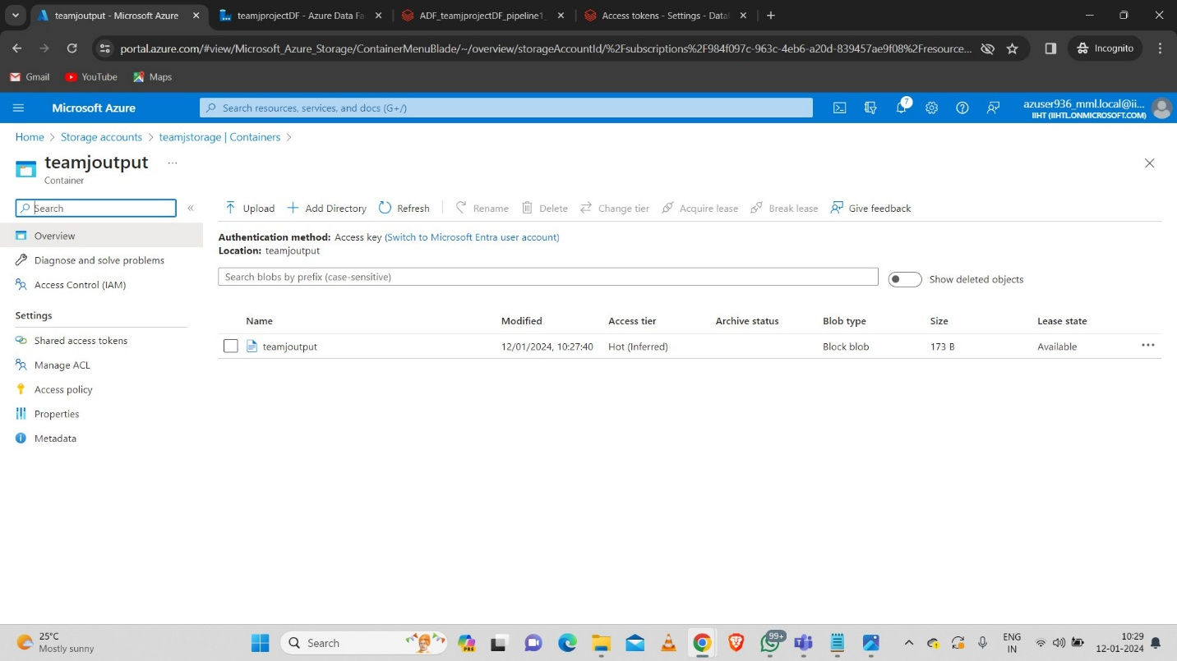
10. Copying The Aggregate Data Using Data Flow Activity:

Slide 19
11. Conclusion:
In conclusion, implementing a daily data aggregation pipeline using Azure Data Factory and Azure Databricks offers a robust and scalable solution for handling raw data and deriving meaningful insights on a daily basis. This integration provides a seamless workflow that combines the data movement capabilities of Azure Data Factory with the powerful data processing and analytics features of Azure Databricks.

